Slide 1
DistracNot Team Hocus-Focus
Faerie Srivarshan Ashvath

Slide 2
Project analysis slide 6
Introduction
This pandemic has made online classes a necessity. But having students devote their attention to the screen is not a piece of cake. We at Hocus-Focus have came up with an exciting and innovative solution to keep them engaged. Every few minutes, the student will be prompted with a question and exciting part is that these questions have nothing to do with the tutor and is auto-generated by the system. The scores they obtain decide their attendance.

Slide 3
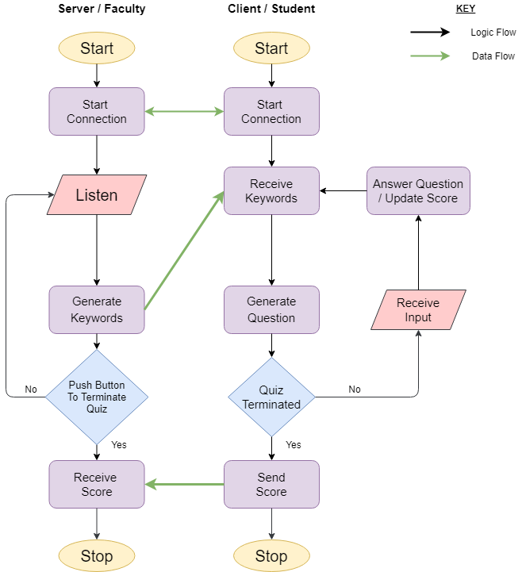
Flow Chart

Slide 4
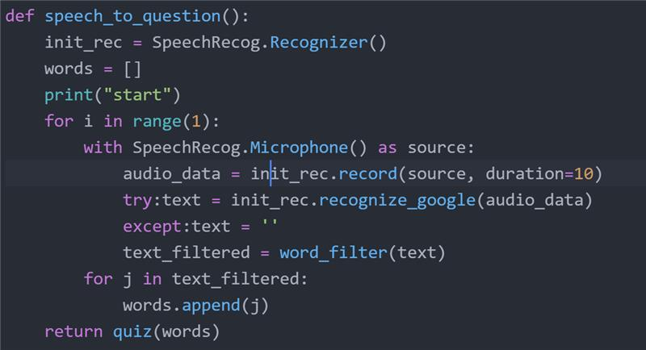
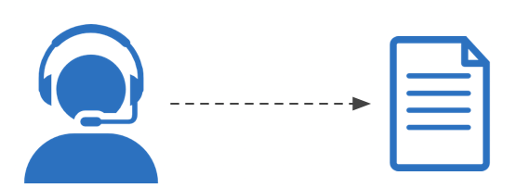
Speech to text
Faculty Lecture
Questions

Slide 5

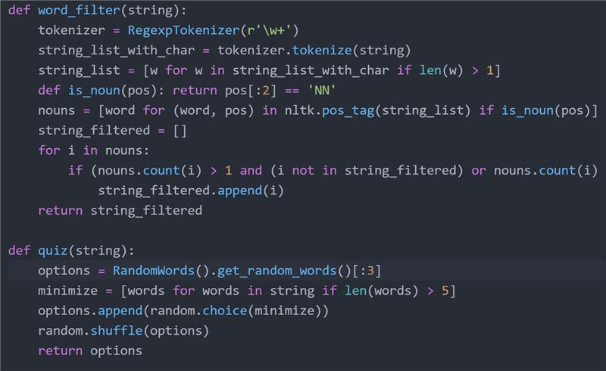

Keywords to Questions

Slide 6
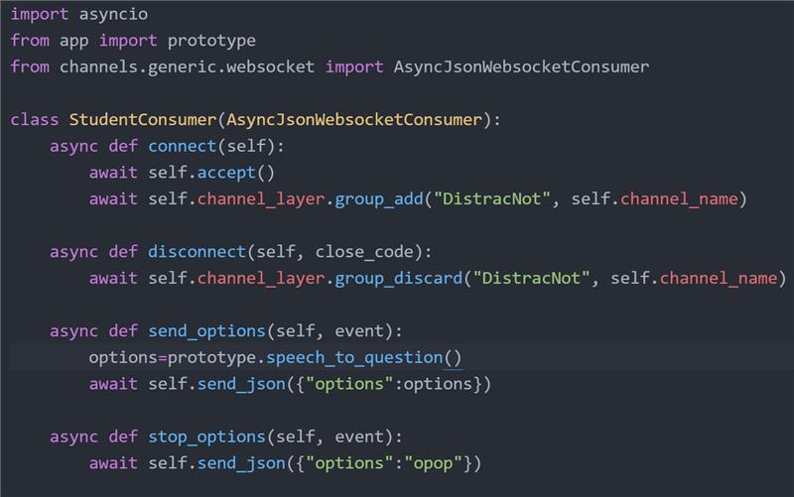
Socket Programming
Server- side

Slide 7
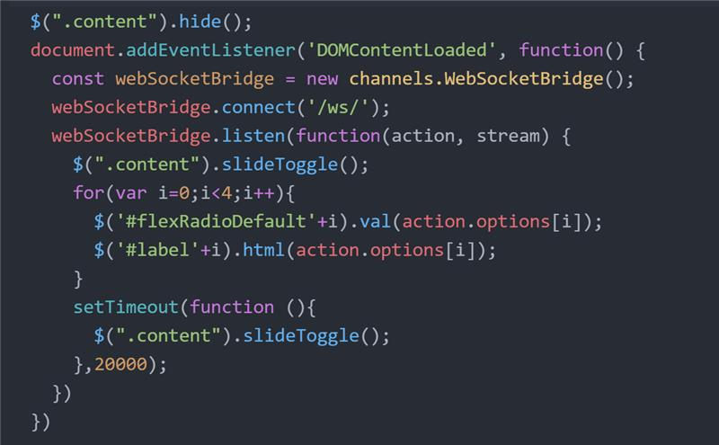
Socket Programming
Client- side

Slide 8
Project analysis slide 3
What next?
Need to tackle network issue by providing a predefined set of questions to make sure that the student is attentive.
Show each students’ final quiz score to the faculty at the end of the class.
Implement error handling in required area.

Slide 9
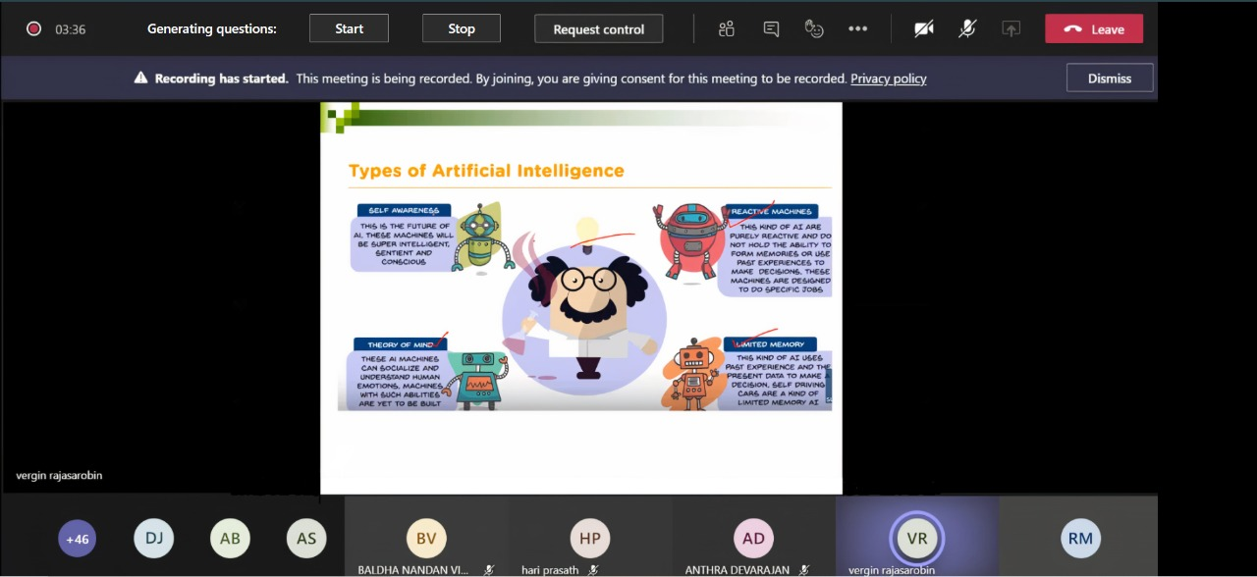
User Interface
A basic illustration on how the product works alongside Microsoft teams-
Faculty UI :

Slide 10
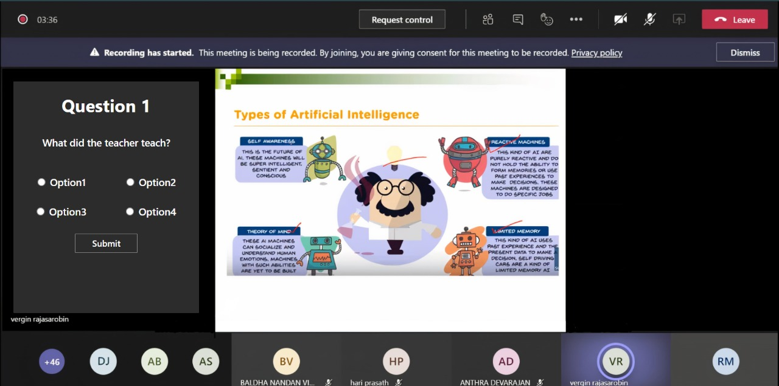
Project analysis slide 6
User Interface
A basic illustration on how the product works alongside Microsoft teams-
Student UI :

Slide 11
Thank You

